Slide 1
Introduction to Programming in R
Pat Callahan
UCSF Memory and Aging Center
5/??/2020
Notes:
Everyone is going to be on mute by default
Feel free to ask questions in the chat, and please note the slide # that your question pertains to. I’ll answer questions mid-way through the presentation, and at the end

Slide 2
Presentation Goals
Broad introduction to the R programming language
Overview of R’s key components
Introduce the {tidyverse}
Notes:
Can’t begin a discussion of R without introducing the idea of functional programming, for which R is heavily known
My goal is not to give you all of the information on every topic; there’s simply too much to cover, and so I want to do what I can to tie together a lot of these disparate topics

Slide 3
Functional Programming
Definition is arbitrary, and somewhat ethereal
Concept, !framework
Computation by evaluating functions
Programs written under assumption of (relatively) immutable data structures
X -> Y, always
Notes:
Some of you may have previously heard of object-oriented programming which is a mainstay concept in coding languages
It’s possible to do OOP in R, but it’s really known for being functional.
What does functional mean? Arbitrary concept, no hard-set definition; it’s a concept rather than a digital framework of some sort

Slide 4
History of R
Derived from the S language in the 90s
Initial 1.0 release February 2000 (Ihaka and Gentlemen)
Reached 4.0.0 in April!
Designed specifically to be an open-source tool for statistical analysis
Extensibility
Notes:
Note that upgrading to 4.0 might cause problems. IF YOU ENCOUTNER A PROBLEM ON MacOS: I recommend deleting all R/RStudio installation files, and redownloading

Slide 5
R Cons
Derived from S, but also implements C and FORTRAN
Slow; technical debt; some oddities in code
Can have a steep learning curve
Base R function error messages can be obtuse
Ugly base graphs
Lost in a maze of packages

Slide 6
Alternatives
Python
MATLAB
JavaScript
Julia
SAS
Others

Slide 7
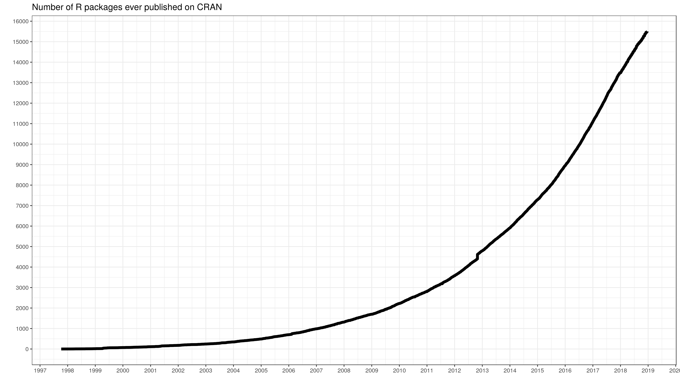
R Pros
Free! Now and always
Incredible documentation and help networks
Stack Overflow, RStudio Community, GitHub, etc.
Widely implemented in research and data science worlds
Possibly the most widely-taught language in American universities now
Your current and future colleagues will know R
13th most popular programming language
Quantity of packages
>15,000 CRAN packages
Variety of packages

Slide 8
Getting Started
Download R from the R Project website
Download RStudio interactive development environment
Technically optional, but you’ll hate using the base IDE
Optional: download Xcode (Mac)
Needed for compiling some R packages

Slide 9
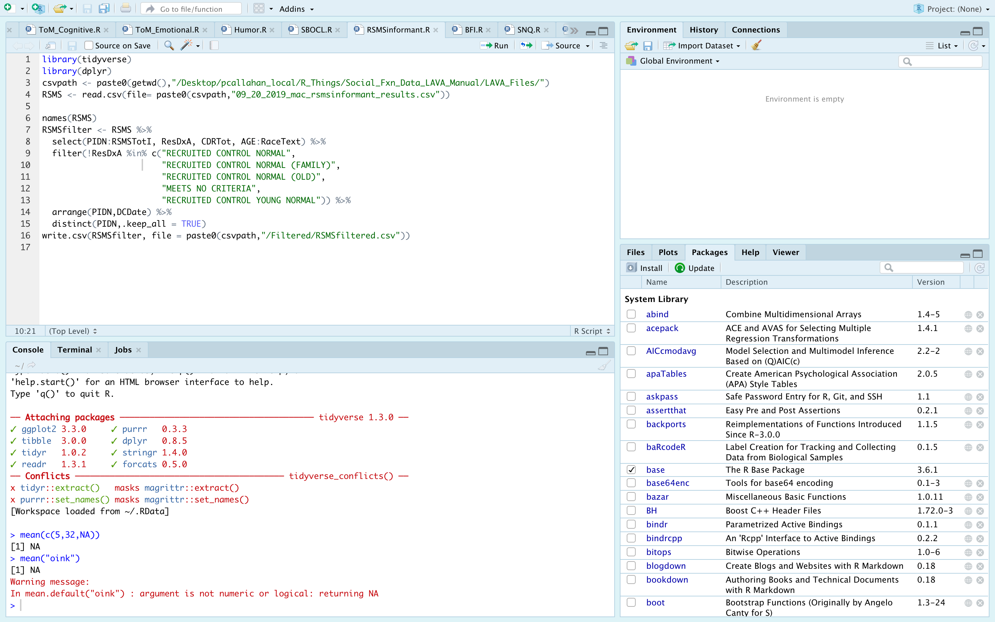

Slide 10
Notes:
Four sections: source, environment, console, and viewer/help window

Slide 11
Notes:
source

Slide 12
Notes:
environment

Slide 13
Notes:
console

Slide 14
Notes:
Viewer/helper

Slide 15
Simple R Syntax
Object assignment:
Use <- or =
Function calls:
Foo(x, …)
Notes:
Start a note line using “#”
Reserved namespaces
TRUE, FALSE, if, NA, NULL, arithmetic operators (+, -, etc.)
Objects starting with “_” or numbers
Case sensitive

Slide 16
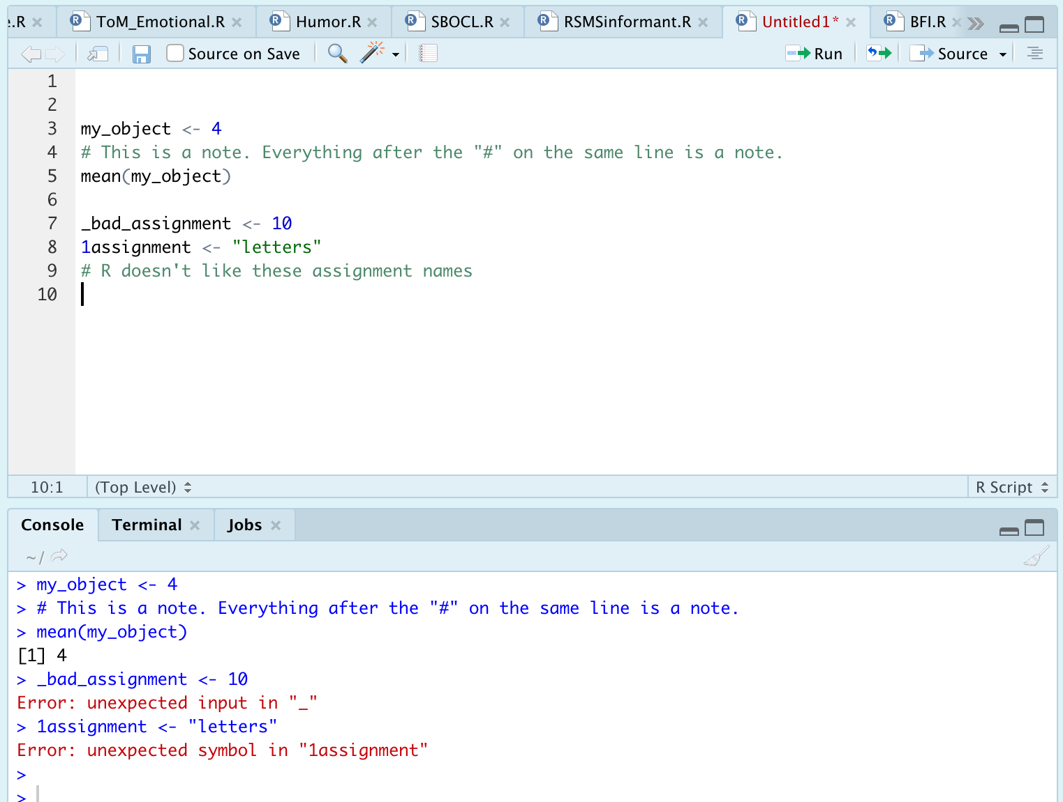
R Syntax: Examples

Slide 17
R Infix Operators
Functions/methods enabling basic expressions
“Infix” refers to the placement of the operator between two variables
What you’ll care about in the beginning:
+, -, *, /, ^,>, <, >=, <=, ==, &, |, =
Complete list at http://applied-r.com/data-infix-operators-in-r/

Slide 18
Booleans
Represent the outcome of a binary evaluation statement
FALSE or TRUE
R also represents booleans as numeric values 0 and 1
This is done under the hood, but means you can perform calculations with boolean values

Slide 19
And/Or
Vectorized evaluations
The & operator is “and”
Each statement to an & statement requires explicit arguments. That is, `data = 4 & 5` is not valid while `data = 4 & data = 5` is
There is a short cut for some instances like this.
The | operator is “or”
Same rules apply as in the “and” statements
&& and || are scalar versions of these statements
Returns only a single TRUE or FALSE statement

Slide 20
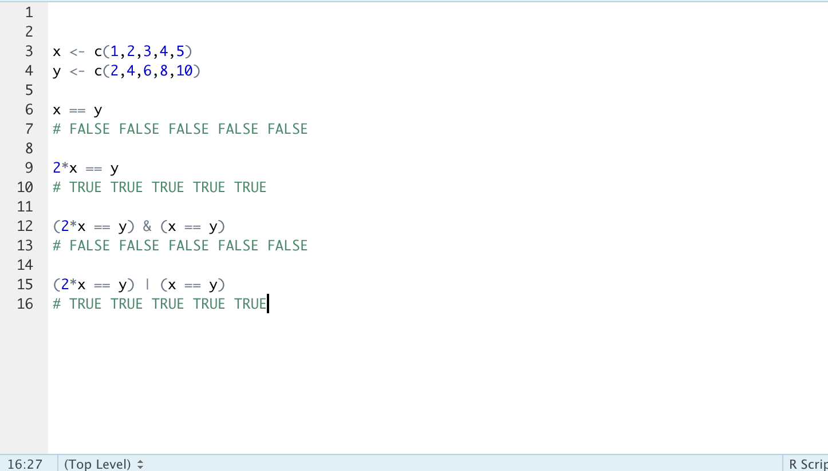
And/Or: Example

Slide 21
R Classes
What is a class?
Determination of the data being handled
Alters how functions can/will treat the data
Why does this matter?
Troubleshooting!
What are the classes in R?
Character, factor, numeric (integer or double) logical, raw, complex
Notes:
Important! Strictly speaking, classes aren’t the full story here, but they’re what really matters. The deeper underlying data structure is the “type” of the data
I find the information regarding “type” to be less informative, however, and troubleshooting ”class” is sufficient 99% of the time

Slide 22
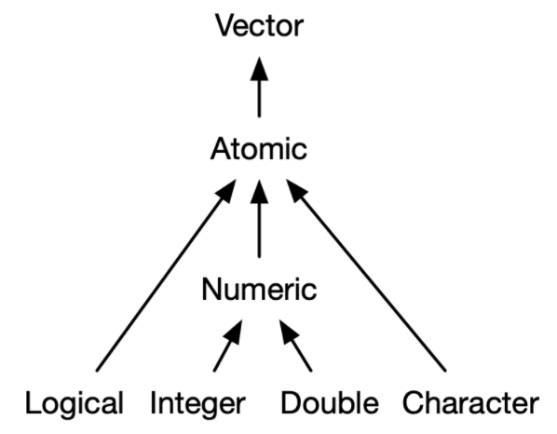
R Classes: Atomic Hierarchy
Notes:
We are scientists, not mathematicians so we don’t need to respect integers.
Factors are NEVER of the atomic type

Slide 23
R Classes: Numeric
Can be represented as either integer or double
Integers can be explicitly declared by typing “L”
Ex: the integer ten can be explicitly written 10L
Really only impacts processing speeds, but important to know as you will see both

Slide 24
R Classes: Factors
Similar appearance to characters
Data structure is actually as an integer!
Class() = factor, but typeof() = integer
Notes:
Factors warrant their own discussion because of how important they will be for grouping analyses
Similar to character in that you will see strings printed out and words can still be read by you as a character class would
Return to my earlier anecdote about classes vs types. This is one important place where you should have this anecdote in mind. It will save you a lot of time when working with factors

Slide 25
R Classes: Factors
Factors contain levels represented by numbers
Initial levels determined by alphanumeric order
Can be either numbers or strings
Note that they are NOT of the numeric class—you can set numerics to be factors if desired
See factor(), ordered(), and relevel() for help
Notes:
Factors warrant their own discussion because of how important they will be for grouping analyses
Exercise: make a factor out of “easy” “medium” and “hard” to see the ordering results

Slide 26
R Classes: Important Functions
Will often need to check classes and convert between classes
Check classes
Class()
Is.factor(), is.numeric(), is.character(), as.logical(), as.date()
Change classes
As.factor(), as.numeric(), as.character(), is.logical(), is.date()
Notes:
Factors warrant their own discussion because of how important they will be for grouping analyses
Exercise: make a factor out of “easy” “medium” and “hard” to see the ordering results

Slide 27
R Functions
Take an object and a set of arguments
Object is typically a vector or dataframe
Arguments should be named explicitly
R accepts positional and partial matching, however
Idea and syntax will be similar to most any other programming languages
User-defined and built-in functions

Slide 28
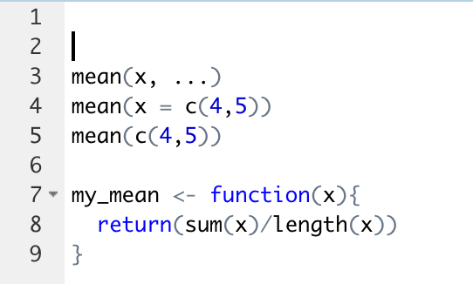
R Functions: Example

Slide 29
R Functions: For Loops
Can use for loops to iteratively generate values when needed
However, R is a vectorized language—objects are stored as vectors, and functions will process vectors as such
Avoid for loops!
Comprehension
Speed, speed, speed
Notes:
I was taught for loops by my professors in undergrad, but they probably learned to do these in other languages where it makes sense so it’s a place where I depart drastically.
In summary, I will delete your code if you write a for loop

Slide 30
R Structures: Vectors
Every object is a vector (for the most part)
Vectors are sequences of items of the same data type
WARNING: R will make every item be the same data type
”Atomic vectors”

Slide 31
Remember me?
Notes:
We are scientists, not mathematicians so we don’t need to respect integers.
Factors are NEVER of the atomic type

Slide 32
R Structures: Lists
Can be thought of as similar to a vector except all objects retain their identities
Ex: list(1, TRUE, “character”, factor(hello, goodbye))
Objects in a list can be anything: a vector, a single number, multiple data frames
Lists can contain lists!
Powerful feature useful for iterative processes, nested data, and other situations

Slide 33
R Structures: Matrices & Arrays
Matrix: unlabeled N x M data space
Transposable (if ever needed)
Useful for speed + efficiency
Must be atomic
Array: stacked matrices into 3D space
Notes:
Again, going to disrespect mathematicians here. I don’t care

Slide 34
R Structures: Data frames
Bread and butteR of data representation
csv, .xlsx, .rdata
Generic term for storing data in a 2D format
Rows = observations, columns = variables
Implemented in a variety of packages and manners
Generic R method, {data.table}, {tibble}
How do I know what kind of data I have?
Class() fxn
Dependent on package used to read-in data

Slide 35
*Tibbles*
Base R data table structure
stringsAsFactors = TRUE
Printing method (ugly)
Data.table
Fast
Still ugly
Tibbles
Simultaneously data frame, data table, and tibble
stringsAsFactors = FALSE
Designed to work with {tidyverse}
Superior print method
Notes:
I previously mentioned that R has some baggage associated with it
Base data frame sets stringsAsFactors = T (super annoying), prints the whole object
Keep an eye out for the vroom package

Slide 36
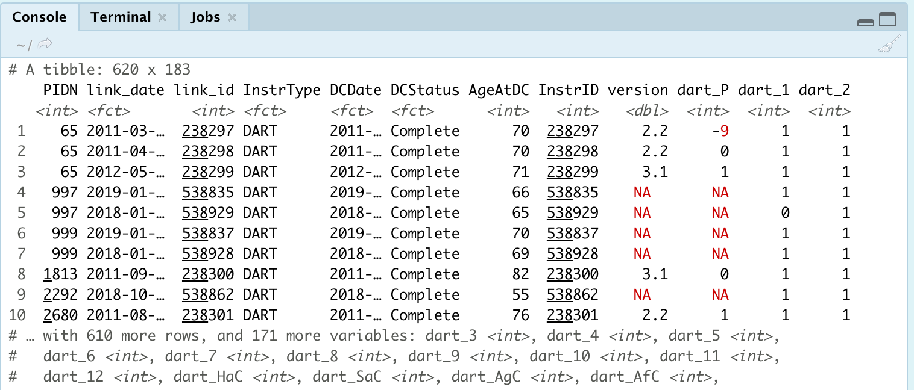
Tibbles: Example

Slide 37
{tidyverse}
Notes:
A tibble is one of the principal components of the tidyverse so this is a good transition point

Slide 38
What is the {tidyverse}?
Collection of packages that are indispensable in the R data science community
{ggplot2}, {readr}, {dplyr}, {tibble}, {stringr}, {purrr}, {lubridate}, {magrittr}, {glue}, {rlang}
Developed by Hadley Wickham and many others of the RStudio Team
Occasionally called the Wickham-verse

Slide 39
Advice: Learn {tidyverse}
Notes:
Structure your learning around this
It is hands-down the most complete and most used ecosystem of packages
You will understand SO and RStudio community questions infinitely better when you see that most questions involve or include fxns from the tidyverse

Slide 40
Starting Packages
{ggplot2}
{readr}/{readxl}
Use read_csv() or read_excel()
{magrittr}
The pipe function, %>%
{dplyr}
5 verbs for data manipulation
Notes:
Core, essential packages to know from the tidyverse
Ggplot2 will be mentioned, but not covered in depth. That’s a whole separate series of presentations
We’re going to proceed in, what I believe to be, increasing order of importance

Slide 41
{ggplot2}
One of the 3 main plotting systems in the R ecosystem
Lattice and base
Consistent syntax for plotting data, highly customizable, and good looking out of the box
Too much to cover for this lecture
Notes:
Three main plotting ecosystems tradtionally: base R, lattice, and ggplot2.
Base R is ugly, although improved with 4.0 release
Lattice has fallen by the wayside. It tried to be a mix of base R and ggplot2
Ggplot2 undoubtedly most popular, take my word for it. BBC, 538, and other websites actually build graphs using ggplot2 (with their own custom themes—you can actually download the BBC default themes.) I present no further proof.
Also take a look at plotly and gganimate for interactive and/or animated graphs

Slide 42
Starting Packages
{ggplot2}
{readr}/{readxl}
Use read_csv() or read_excel()
{magrittr}
The pipe function, %>%
{dplyr}
5 verbs for data manipulation

Slide 43
{readr}
Multiple functions for reading-in delimited files
Tab, colon, period, etc.
readr::read_csv(“data.csv”)
readxl::read_excel(“data.xlsx”, sheet = 1)
Notes:
New item! Note the {package} and :: combination. This notation allows you to explicitly call function X from package Y

Slide 44
Starting Packages
{ggplot2}
{readr}/{readxl}
Use read_csv() or read_excel()
{magrittr}
The pipe function, %>%
{dplyr}
5 verbs for data manipulation

Slide 45
{magrittr}
Package supplies the pipe, %>%, operator
Allows you to write functions in a continuous flow without wrapping excessively
foo(foo(foo(foo(foo)))))
Did I put the correct number of closing parentheses?!
Read the pipe as an “and then” statement
Read_csv(“data.csv”) %>% mean(col1)
Read in my .csv AND THEN find the mean of col1
Notes:
Also, my syntax for mean() is technically not a real function call, but we’ll get to that. Just want to demonstrate the idea concisely here.

Slide 46
Starting Packages
{ggplot2}
{readr}/{readxl}
Use read_csv() or read_excel()
{magrittr}
The pipe function, %>%
{dplyr}
5 verbs for data manipulation

Slide 47
Notes on {dplyr}
Developed as a coherent ecosystem for data manipulation
Improved syntax over base R data cleaning operations
Familiar to SQL users
Start with learning this package when it comes to data cleaning
Notes:
Familiar to SQL users—in fact, the functions we’re about to see are exact counterparts, and they generate SQL code under the hood so you can interact directly with a SQL database if that’s a need. Great if, for example, working with high dimensional data from an EMR or other database
Note that the predecessor the dplyr, plyr, is now an abandoned package. If you have code dependent on plyr, that’s fine—it will keep working. However, you should switch to dplyr
I note this because a lot of older StackOverflow results will talk about plyr, and you should know these are distinct packages

Slide 48
{dplyr}: select()
Allows you to choose columns from a data frame
Don’t need to quote column names
Special operators
Remove values with “-”
everything()
Can call series of columns with ”:”
var2:var15

Slide 49
{dplyr}: filter()
Create arbitrary conditions on which to filter the dataset
Generic function for cleaning normally down step-wise and verbose in base R
Base R: dataframe[var1 > 1, ]
Dplyr: filter(dataframe, var1 > 1)
Can accept any number of filtering arguments by separating with “,”
Note that the comma will be read as AND within any filter call

Slide 50
{dplyr}: mutate()
Create new columns in a dataframe
Do not need to pre-initialize the column like you would in base R
New column will automatically have N rows to match the dataframe
Essentially any operation or set of values is allowed
Ex: create a new column that is 2x an existing column

Slide 51
*Special Topic* {dplyr}: mutate_at()
This is a special version of mutate(), referred to as a scoped variant
Scoped variants exist for all dplyr verbs discussed today, but this is a mainstay for me
Allows you to apply a function or value(s) to existing column(s)
Ex: set out-of-bounds values (88, 99, etc.) to NA

Slide 52
{dplyr}: arrange()
Allows you to sort data on given column(s)
Default ordering is ascending, but can specify descending with desc()
Affects how the dataframe looks when viewed
WARNING: this will alter calculations that depend on row position
Notes:
So you can sort on multiple columns at once. The order in which you write the column names provides precedence information
View can be ascend and descend—main point is to get a view of your dataset

Slide 53
{dplyr}: summarise()
Allows you to create summary variables over the whole dataset
Often paired with the group_by() function to calculate summary vars over certain groups
Returns a tibble with just the results of the summary

Slide 54
Starting Packages
{ggplot2}
{readr}/{readxl}
Use read_csv() or read_excel()
{magrittr}
The pipe function, %>%
{dplyr}
5 verbs for data manipulation

Slide 55
{dplyr}: Worked Example
Order of operations matters
Imagine doing the following sequence without the chain operator
Feel free to ask about other operations you might want to do!

Slide 56
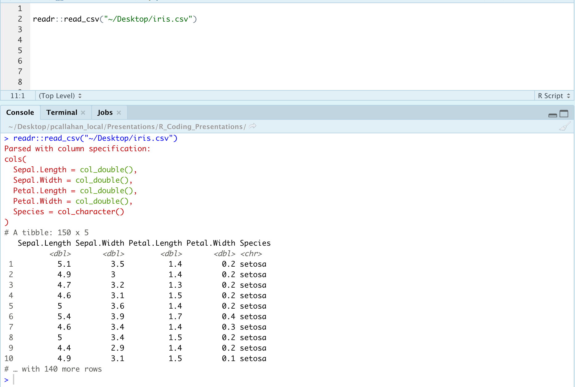

Slide 57
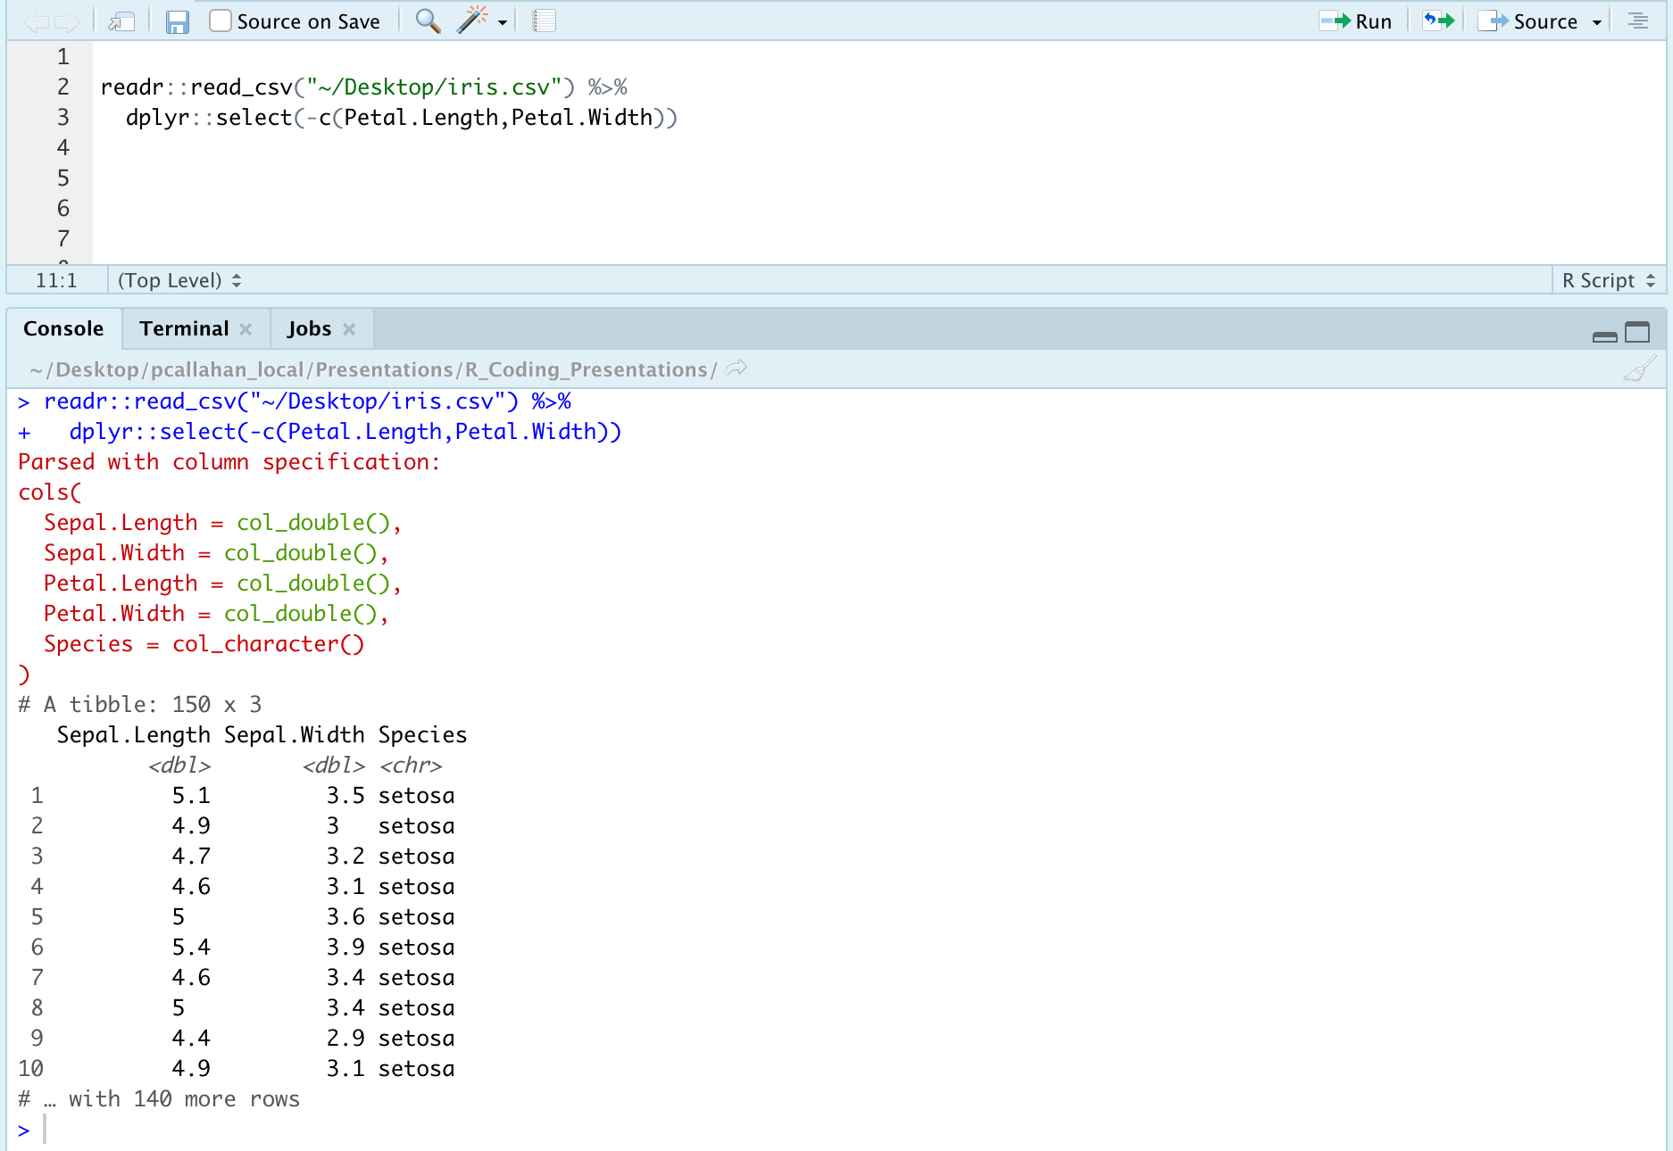

Slide 58
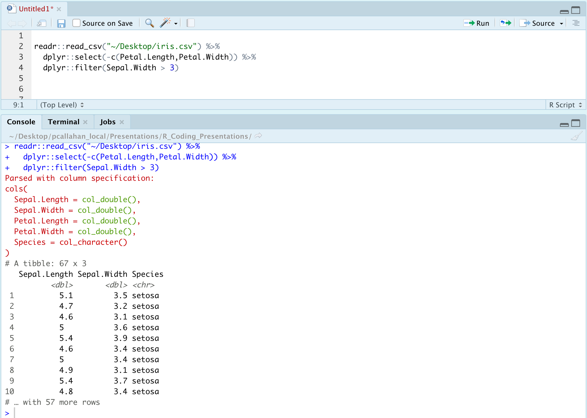

Slide 59
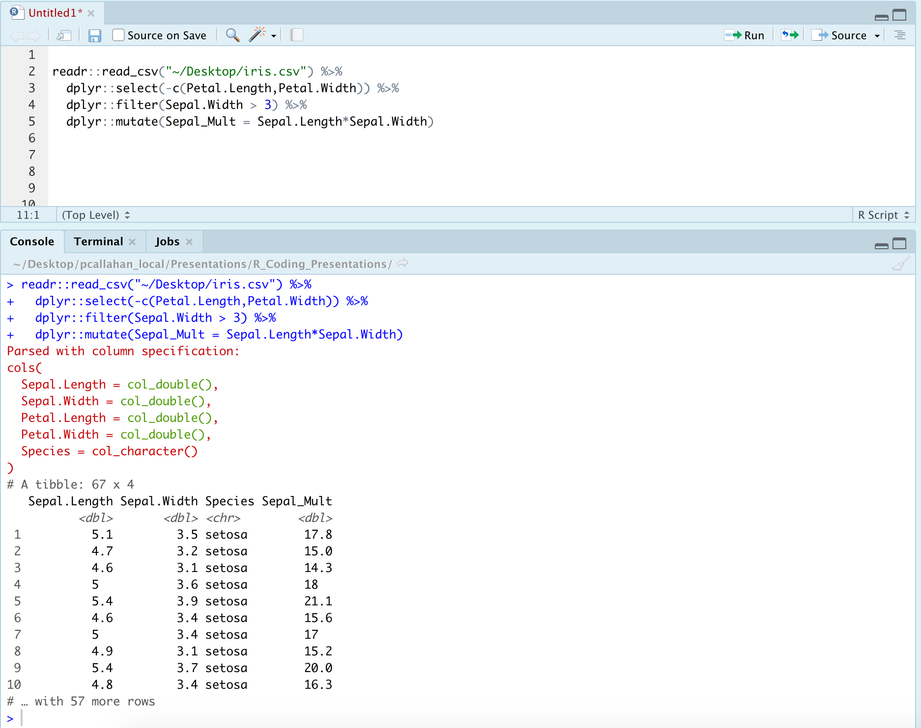

Slide 60
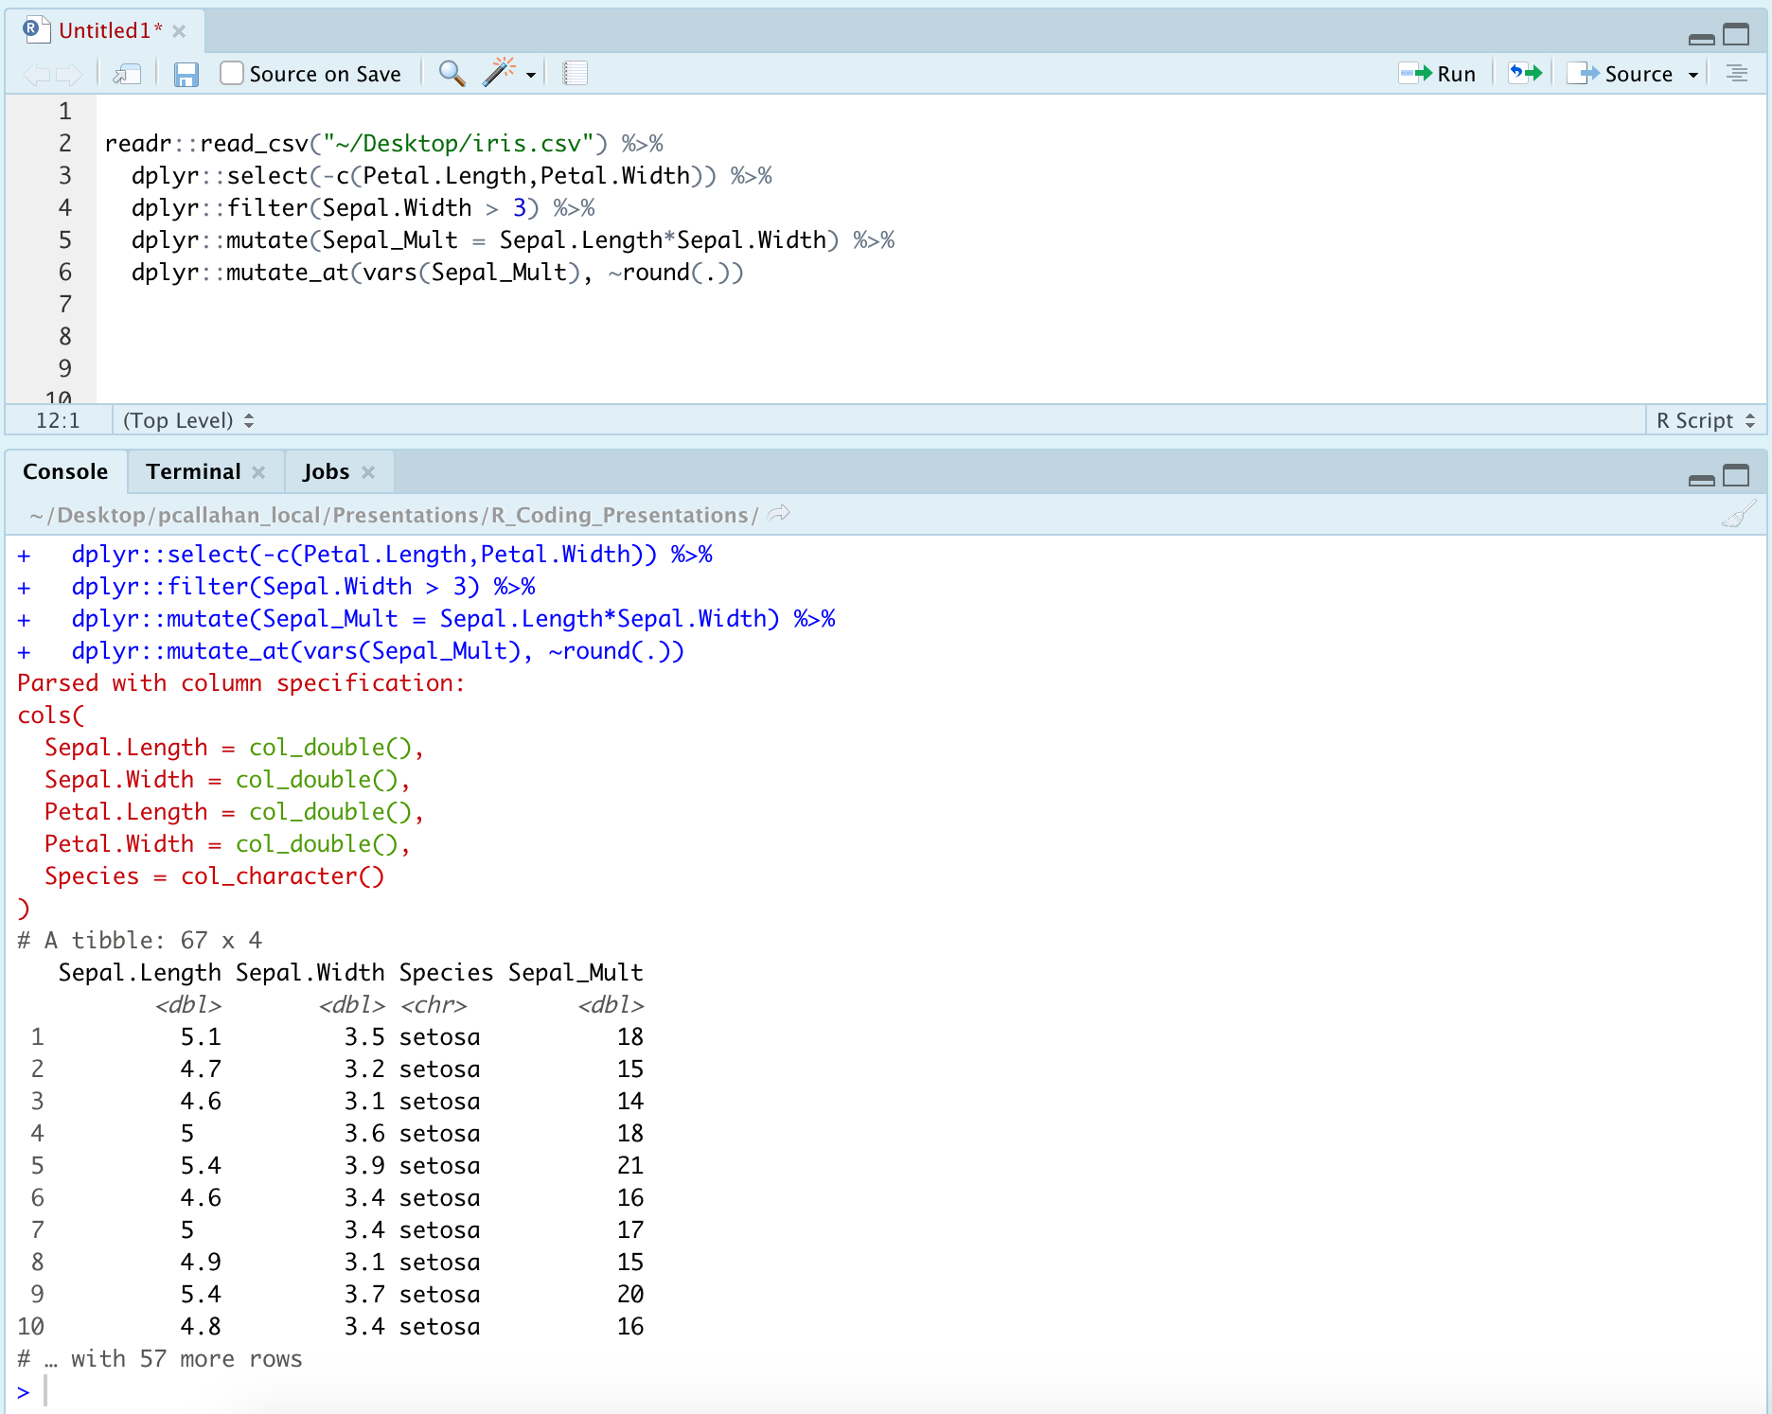

Slide 61
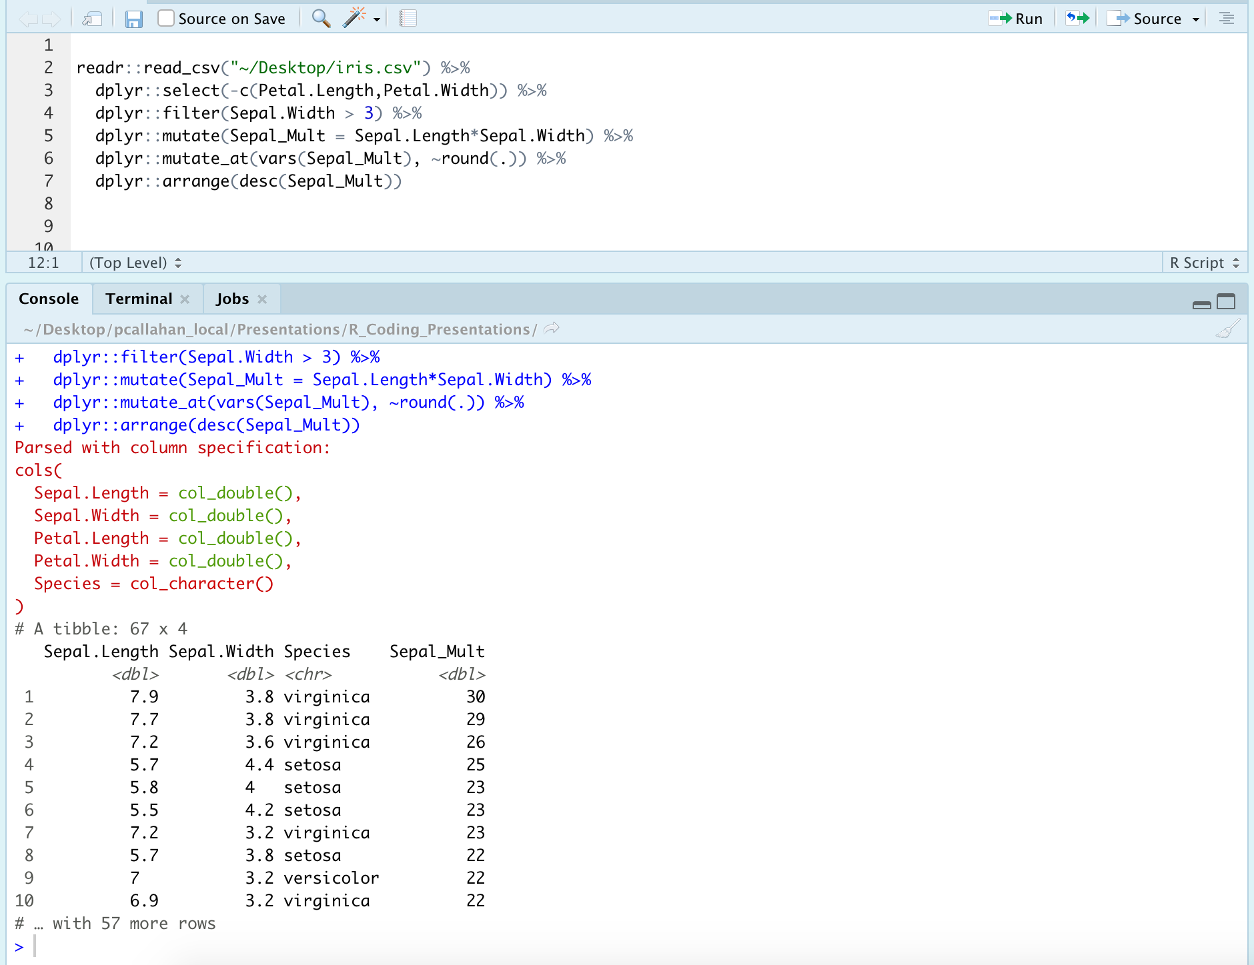

Slide 62
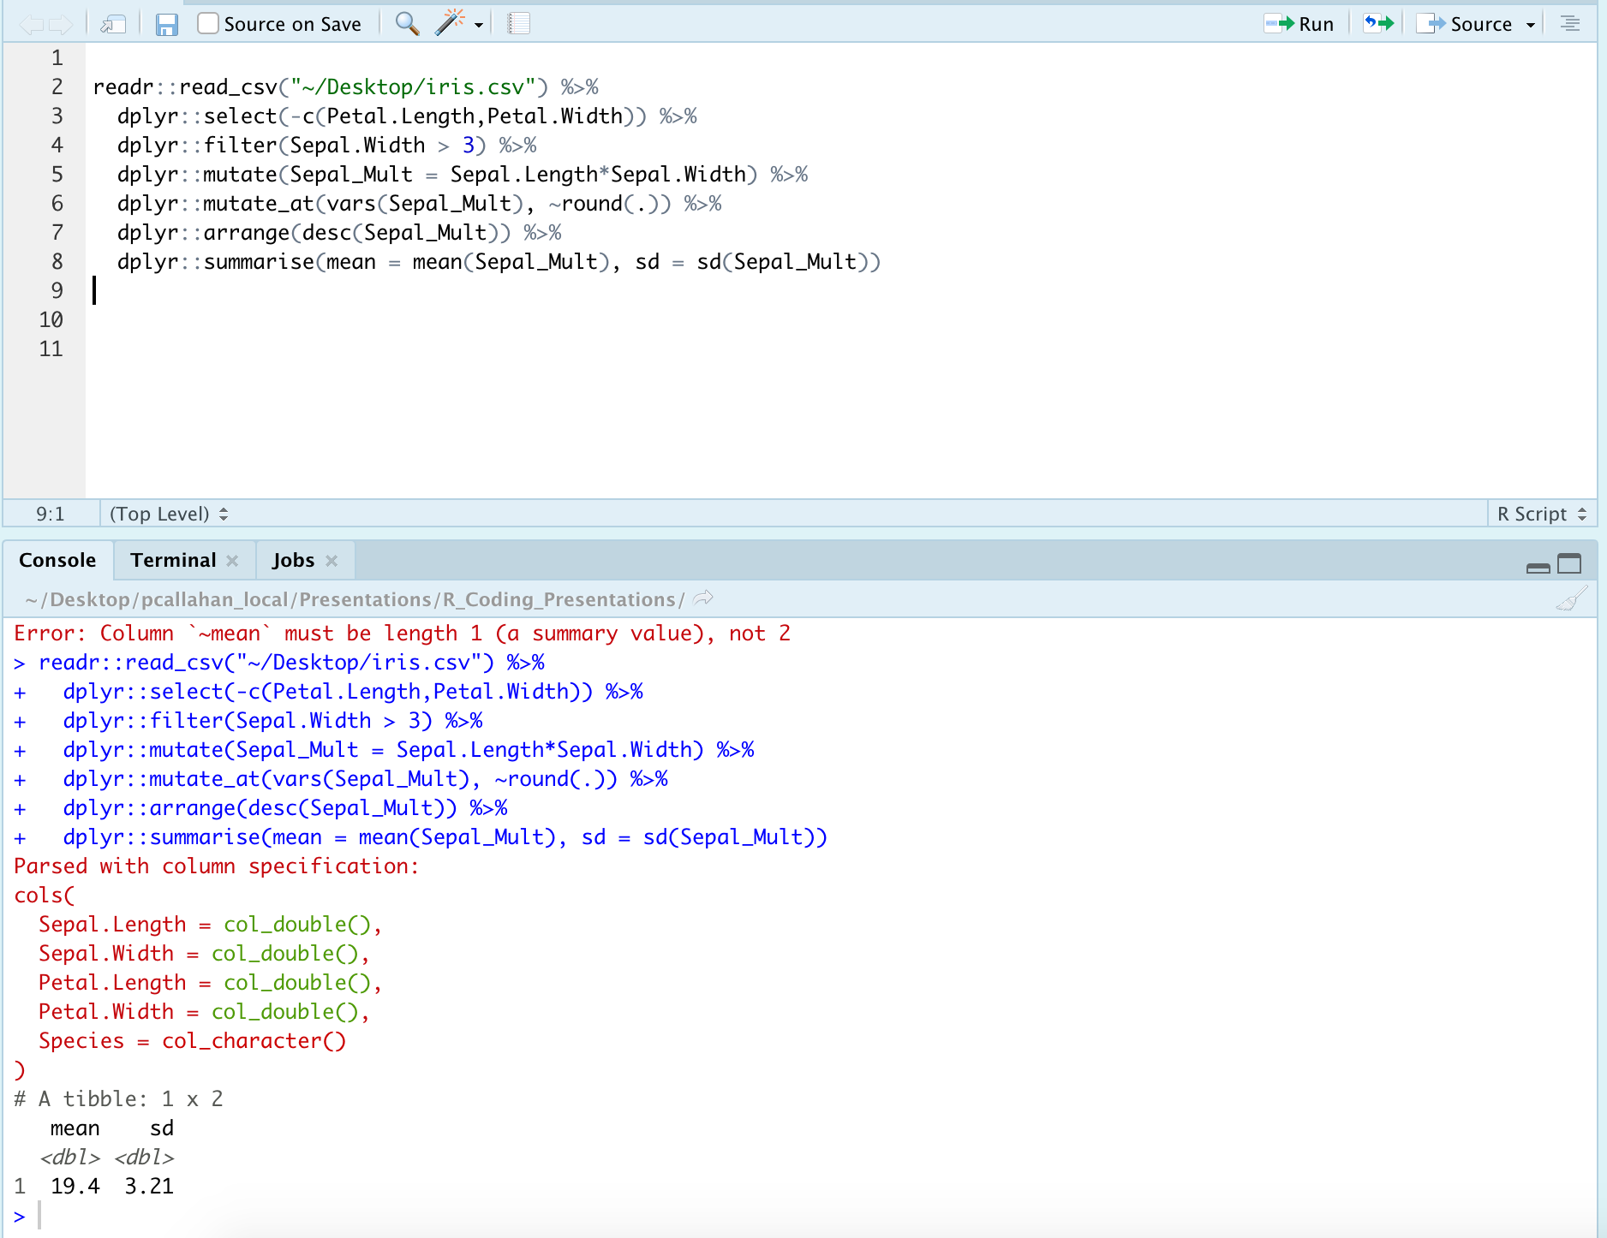

Slide 63
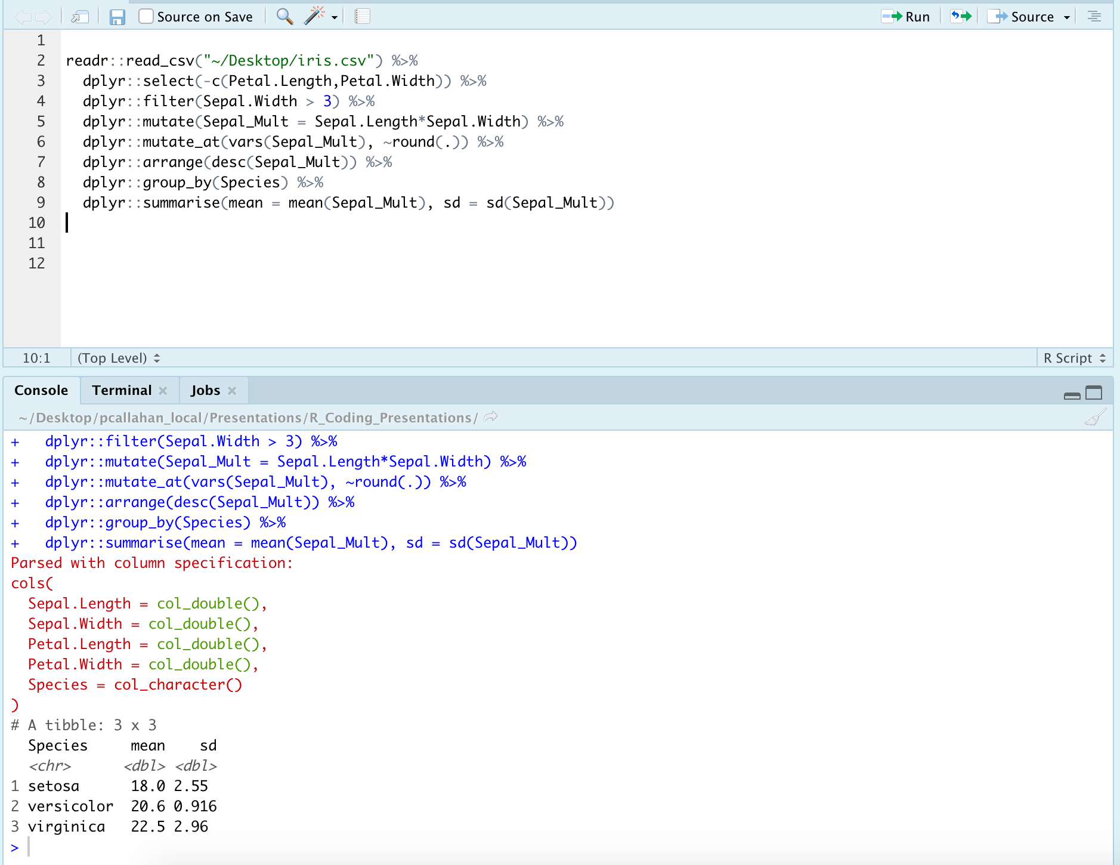

Slide 64
Other Packages, Discovering Data, and Troubleshooting
Notes:
Finished with our main presentation, and going to move on to some closing thoughts and things I think will be beneficial

Slide 65
Other Packages to Consider
{apaTables}
{broom}
{devtools}
{usethis}
{purrr}

Slide 66
Exploration Tools
Look at your table in Excel or using View()
Quantitative information
str()
summary()

Slide 67
Help! (I need somebody!)
?foo or help(foo)
?foo or help(foo)
?foo or help(foo)

Slide 68
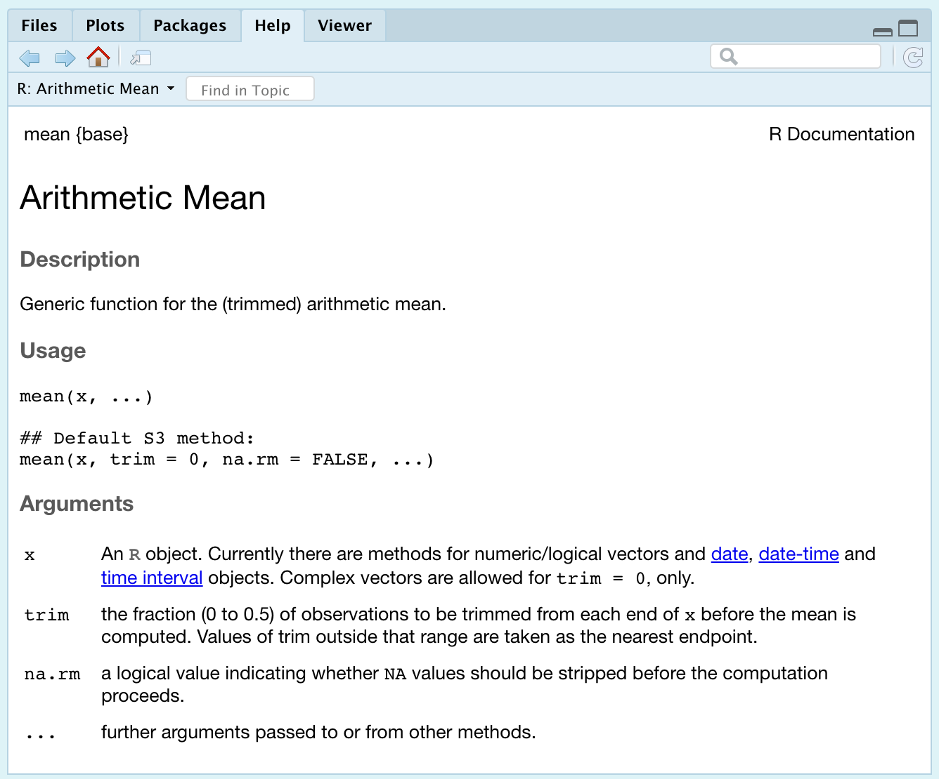
Help! Example

Slide 69
Help! Other Options
Vignette()
Google
Stack Overflow + RStudio Community
GitHub (tread lightly)

Slide 70
Troubleshooting: Clearing Environment
Package conflicts/masks
Declare packages with their functions
Ex: filter() or filter()
Too many objects in the environment to keep track of
Useful cleaning functions
rm( list=ls() )
.rs.restartR()

Slide 71
My Recommended Resources
Online:
Roger Peng and John Leek on Coursera
DataCamp (free and paid options)
https://homerhanumat.github.io/r-notes/index.html
Books:
Beyond Spreadsheets with R
R in Action
In R:
swirl()
RStudio cheatsheets
Notes:
Other books you might encounter:
R 4 Data science: don’t recommend for beginners, but is solid
R in Action 3rd edition: this is a good 2nd book to read
Most books from Manning Publications website are solid
Haven’t fully verify the book by Homer Hanumat, but it was updated just a month ago and seems to cover all the important topics

Slide 72
Questions?

